Slide 1
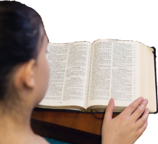
Understand your Bible
Session 48 Acts 27
Welcome

Slide 2
Understand your Bible
Session 48 Acts 27
What we will see in this chapter:
Paul’s advice at the start and during the voyage to Rome
What happened on the journey
How the journey ended

Slide 3
Understand your Bible
Session 48 Acts 27
Let us read Acts 27

Slide 4
Understand your Bible
Session 48 Acts 27
2. Questions
v 1 to 8. What places were mentioned on Paul’s journey?
Sidon, Cyprus, Cilicia, Pamphylia, Myra, Lycia, Cnidus, Crete, Salmone, Fair Havens, Lasea.
(see next slide for a map)

Slide 5
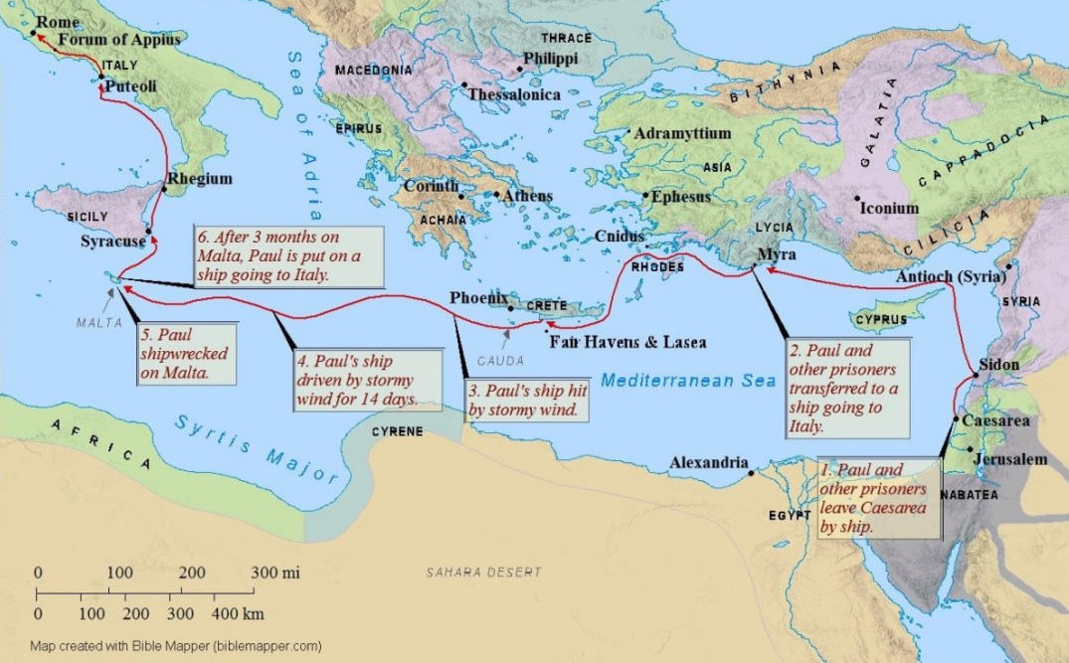

Slide 6
Understand your Bible
Session 48 Acts 27
2. Questions
v 9 to 12. What advice did Paul give and what did the majority on the ship want to do?
Paul warned of certain disaster to the ship and passengers, but the majority wanted to winter in Phoenix, a port of Crete.
v 13 to 20. How did their journey progress?
A soft south wind encouraged them to set sail. Not long after, a stormy offshore wind blew them off course. Unable to control the ship they were driven by the wind for many days and despaired of surviving.

Slide 7
Understand your Bible
Session 48 Acts 27
2. Questions
v 21 to 26. What did Paul tell everybody on the ship?
Paul told them, that an angel had assured him, that there would be no loss of life, but that they must run aground on an island.
v 27 to 32. What happened on the 14th night?
On the 14th night the sailors detected that they were nearing land. They dropped anchors for fear of the rocks and Paul prevented them from abandoning the main ship.

Slide 8
Understand your Bible
Session 48 Acts 27
2. Questions
v 33 to 38. What did Paul say to them?
Paul encouraged them all to eat some food and assured them they would all survive.
v 39 to 44. How did their journey on the ship end?
The ship was run aground in a bay, and all managed to get safely to the land.

Slide 9
Understand your Bible
Session 48 Acts 27
3. Related theme from v 23:
Angels.
Verse(s)
Main point(s)
Genesis 24 v 6 and 7
Abraham tells his servant that God's angel will prepare the way before him and ensure God's promise is kept.
Exodus 23 v 20
God tells the early Israelites that an angel will ensure that God's plan will be carried out.
Psalms 34 v 7
The angel of the Lord stays close to those who fear God.

Slide 10
Understand your Bible
Session 48 Acts 27
3. Related theme from v 23:
Angels.
Verse(s)
Main point(s)
Psalms 103 v 20 and 21
The angels obey God’s word and do his will.
Matthew 18 v 10
Jesus Christ says that his little ones have their angels who see God's face.
Hebrews 1 v 13 and 14
The angels do service for the sake of those who will be saved.

Slide 11
Understand your Bible
Session 48 Acts 27
Comments or questions

