Slide 1
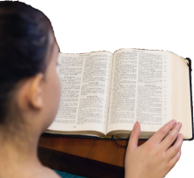
Understand your Bible
Session 49 Acts 28
Welcome

Slide 2
Understand your Bible
Session 49 Acts 28
What we will see in this chapter:
What happened on the island of Malta
What happened when Paul he reached Rome

Slide 3
Understand your Bible
Session 49 Acts 28
Let us read Acts 28

Slide 4
Understand your Bible
Session 49 Acts 28
2. Questions
v 1 to 6. What did the natives of Malta do and how did they react to Paul?
The people of Malta took care of them. They thought that Paul was a god when he felt no harm after a viper bite.
v 7 to 10. How did Paul help Publius?
Paul healed the father of Publius.

Slide 5
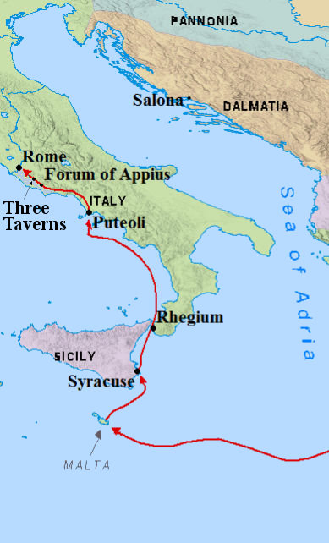
Understand your Bible
2. Questions
v 11 to 16. What places did they visit on the final stage of their journey?
Syracuse, Rhegium, Puteoli, The Market (or forum) of Appius, The Three Taverns, Rome.

Slide 6
Understand your Bible
Session 49 Acts 28
2. Questions
v 17 to 22. On arrival at Rome, what did Paul tell the leading Jews and why did he say he was chained?
He told them that although he had done nothing against their people or the customs of their fathers, he was still arrested. The Romans wanted to set him free but, when the Jews objected, he appealed to Caesar.
He told them that it was because of the hope of Israel that he was chained.
v 23. What did Paul spend his time explaining to the Jews?
He was explaining about God’s Kingdom, and persuading them about Jesus, from the law of Moses and the prophets.

Slide 7
Understand your Bible
Session 49 Acts 28
2. Questions
v 24 to 29. What did Paul say to those who disagreed with him?
Paul said that Isaiah was right when he predicted the Jews’ refusal to listen to God’s message.
The Gentiles however would listen.
v 30 and 31. What did Paul spend the next two years doing?
He was preaching God’s Kingdom, and teaching the things about the Lord Jesus Christ.

Slide 8
Understand your Bible
Session 49 Acts 28
3. First-century Christian beliefs in this chapter
Verse
Belief(s)
v 23
Jesus' work is prophesied in the law and prophets.
v 28
Salvation is being offered to all nations.
v 31
His message is about the Kingdom of God and Jesus Christ.

Slide 9
Understand your Bible
Session 49 Acts 28
Comments or questions

